Slide 1
Please observe a reverent Silence And Ensure all Mobile phones are turned off.

Slide 2
St Michaels Parish
Welcomes you to the celebration of
The Eucharist
33rd Sunday in Ordinary time
18th November 2012

Slide 3
Praise the name of Jesus
Praise the name of Jesus,
Praise him as we pray.
Praise the name of Jesus.
Sing to him all our days.

Slide 4
Let us come unto the lord,
Let us make a joyful noise,
He has healed us through his word,
In all things let’s praise his name.

Slide 5
Praise the name of Jesus,
Praise him as we pray.
Praise the name of Jesus.
Sing to him all our days.

Slide 6
Praise the name of Jesus,
Praise him as we pray.
Praise the name of Jesus.
Sing to him all our days.

Slide 7
Priest: The grace of our Lord Jesus Christ, and the love of God, and the communion of the Holy Spirit be with you all. All: And with your spirit.

Slide 9
Lord Have Mercy
Lord have mercy,
Christ have mercy,
Lord have mercy.

Slide 11
Gloria
Glory to God in the highest
And on earth peace
to people of good will

Slide 12
We praise you
We bless you
We adore you
We glorify you

Slide 13
We give you thanks
For your great glory
Lord God, heavely king
O God almighty Father

Slide 14
Glory to God in the highest
And on earth peace
to people of good will

Slide 15
Lord Jesus Christ
Only begotten Son
Lord God, lamb of God
Son of the Father

Slide 16
You take away
The sins of the world
Have mercy on us

Slide 17
You take away
The sins of the world
Receive our prayer

Slide 18
You are seated
At the right hand
Of the Father
Have mercy on us

Slide 19
Glory to God in the highest
And on earth peace
to people of good will

Slide 20
For you alone
Are the holy one
You alone are the Lord

Slide 21
You alone are the most High
Jesus Christ
With the Holy Spirit in the glory
Of God the Father

Slide 22
Glory to God in the highest
And on earth peace
to people of good will

Slide 24
Psalm
You are my inheritance,
O Lord

Slide 26
Gospel Acclamation
Alleluia, Alleluia
Alleluia, Alleluia
Alleluia, Alleluia
Alleluia, Alleluia

Slide 28
GOSPEL Priest: The Lord be with you All: And with your spirit. Priest: A reading from the holy Gospel according to....... All: Glory to you, O Lord.

Slide 30
Apostles’ Creed
I believe in God
The Father almight
Creator of heaven and earth
And in Jesus Christ

Slide 31
His only Son, Our Lord
Who was conceived
By the Holy Spirit
Born of the Virgin Mary

Slide 32
Suffered under Pontius Pilate
Was crucified,
Died and was buried

Slide 33
He descended into hell;
On the third day he rose
Again from the dead
He ascended into heaven

Slide 34
And is seated at the right
Hand of the Father almighty
From there he will come
To judge the living and the dead

Slide 35
I believe in the Holy Spirit
The Holy catholic church
The communion of saints
The forgiveness of sins

Slide 36
The resurrection of the body
And life everlasting.
Amen

Slide 38
Blessed be God
Blest are you Lord
God of all creation
Thanks to your goodness
This bread we offer

Slide 39
Fruit of the earth
Work of our hands
It will become
The bread of life

Slide 40
Blessed be God
Blessed be God
Blessed be God
Forever amen

Slide 41
Blessed be God
Blessed be God
Blessed be God
Forever amen

Slide 42
Blest are you Lord
God of all creation
Thanks to your goodness
This wine we offer

Slide 43
Fruit of the earth
Work of our hands
It will become
The cup of joy

Slide 44
Blessed be God
Blessed be God
Blessed be God
Forever amen

Slide 45
Blessed be God
Blessed be God
Blessed be God
Forever amen

Slide 47
Priest: Pray my brothers and sisters, that my sacrifice and yours may be acceptable to God, the almighty Father.

Slide 48
All: May the Lord accept the sacrifice at your hands for the praise and glory of his name, for our good and the good of all his holy Church.

Slide 50
Priest: The Lord be with you. All: And with your spirit. Priest: Lift up your hearts. All: We lift them up to the Lord.

Slide 51
Priest: Let us give thanks to the Lord our God. All: It is right and just.

Slide 53
Holy
Holy, holy,
Holy Lord God of Hosts
Heaven and earth
Are full of your glory

Slide 54
Hosanna in the highest
Blessed is He who comes
In the name of the Lord
Hosanna in the highest

Slide 56
Save us saviour of the world
For by your cross
And resurrection
You have set us free

Slide 58
Amen, Amen, Amen, Amen
Amen, Amen, Amen, Amen

Slide 60
Priest: The Lord be with you. All: And with your spirit.

Slide 62
Peace
May the peace of the Lord
Be with you
With your friends
And your family too

Slide 63
Let it be let it grow
And everywhere you go
May the peace of the Lord
Follow you

Slide 64
Lamb of God
Lamb of God, Lamb of God
You take away the sins
Of the world have mercy
On us Lamb of God

Slide 65
Lamb of God, Lamb of God
You take away the sins
Of the world have mercy
On us Lamb of God

Slide 66
Lamb of God, Lamb of God
You take away the sins
Of the world
Grant us, grant us peace

Slide 68
Priest: Behold the Lamb of God, behold him who takes away the sins of the world. Blessed are those called to the supper of the Lamb.

Slide 69
All: Lord, I am not worthy that you should enter under my roof, but only say the word and my soul shall be healed.

Slide 71
In Love for me
This is my body
Broken for you
Bringing forgiveness
Making you free

Slide 72
Take it and eat it
And when you do
Do it in love for me

Slide 73
This is my blood
Poured out for you
Bringing you wholeness
Making you free

Slide 74
Take it and drink it
And when you do
Do it in love for me

Slide 75
This is my body
Broken for you
Bringing forgiveness
Making you free

Slide 76
Take it and eat it
And when you do
Do it in love for me

Slide 77
This is my blood
Poured out for you
Bringing you wholeness
Making you free

Slide 78
Take it and drink it
And when you do
Do it in love for me

Slide 79
Lord I offer my Life to you
All that I am,
All that I have
I lay them down
Before you, oh Lord

Slide 80
All my regrets,
all my acclaims
The joy and the pain,
I'm making them yours

Slide 81
Lord, I offer my life to you
Everything I've been through
Use it for your glory

Slide 82
Lord I offer my days to you
Lifting my praise to you
As a pleasing sacrifice
Lord I offer you my life

Slide 83
Things in the past,
things yet unseen
Wishes and dreams
that are yet to come true

Slide 84
All of my heart,
all of my praise
My heart and my hands
are lifted to you

Slide 85
Lord, I offer my life to you
Everything I've been through
Use it for your glory

Slide 86
Lord I offer my days to you
Lifting my praise to you
As a pleasing sacrifice
Lord I offer you my life

Slide 87
What can we give
That you have not given?
And what do we have
That is not already yours?

Slide 88
All we possess
Are these lives we're living
That's what we give to you, Lord

Slide 89
Lord, I offer my life to you
Everything I've been through
Use it for your glory

Slide 90
Lord I offer my days to you
Lifting my praise to you
As a pleasing sacrifice
Lord I offer you my life

Slide 91
Make me like you
Lord, make me like you
Please make me like you
You are a servant
Make me one too

Slide 92
O Lord I am willing
Do what you must do
To make me like you Lord
Please make me like you

Slide 93
Lord, make me like you
Please make me like you
You are a servant
Make me one too

Slide 94
O Lord I am willing
Do what you must do
To make me like you Lord
Please make me like you

Slide 96



Slide 97

SATURDAY 8TH DECEMBER
PARISH HALL (NAGLE COLLEGE)
VIGIL MASS at 6PM
CHRISTMAS CAROLS at 8PM
Food & Drink will be on sale from 7pm

Slide 98


Slide 99

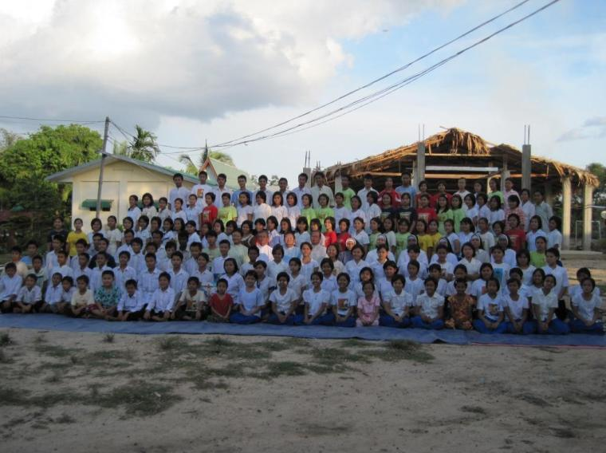
ORPHANAGE IN MYEIK MYANMAR (BURMA

Slide 100
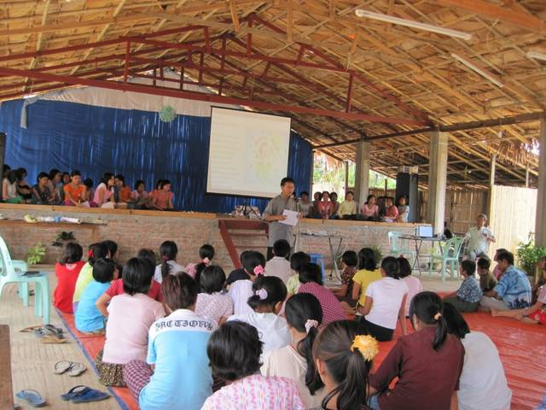

ORPHANAGE IN MYEIK MYANMAR (BURMA

Slide 101

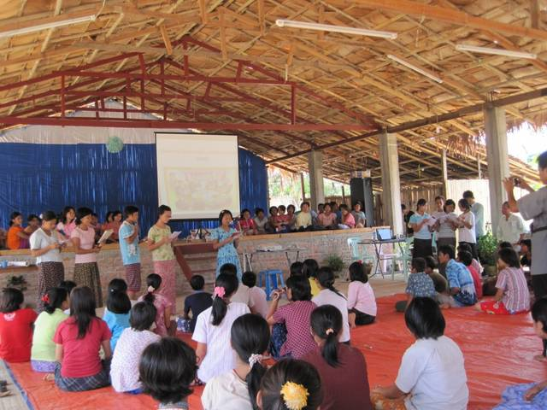
ORPHANAGE IN MYEIK MYANMAR (BURMA

Slide 102


Slide 103


Slide 104
Priest: The Lord be with you. All: And with your spirit.

Slide 105
God is good
God is good all the time
He put a song of praise
In this heart of mine

Slide 106
God is good all the time
Through the darkest night
His light will shine

Slide 107
Good is good
Good is good
All the time

Slide 108
If you’re walking
Through the valley
There are shadows
All around

Slide 109
Do not fear
He will guide you
He will keep you
Safe and sound

Slide 110
He has promised
To never leave you
Nor forsake you
And His word is true

Slide 111
God is good
All the time
He put a song of praise
In this heart of mine

Slide 112
God is good all the time
Through the darkest night
His light will shine

Slide 113
God is good
God is good
God is good
All the time

Slide 114
Thank you
for being a part of our
celebration

